Slide 1
Reminders
Quiz on TUESDAY 3/20
Final PLA- led study session MONDAY 3/19 at 10am
Study strategies
Read text BEFORE the related lecture
Lecture will highlight key concepts & look at examples
Text will provide detail and additional examples
Use the ‘chapter objectives’ as study guide
Practice with the ‘odd’ end of chapter questions – the answers are in the back of your text
First homework assignments
Worksheet on how to identify a primary research article and provide a citation (ie Primary literature citation/PLC#1) due TONIGHT at midnight
Self assessment due SUNDAY at midnight
Starting TODAY: you MUST have a poll everywhere account to get full class participation credit

Slide 2
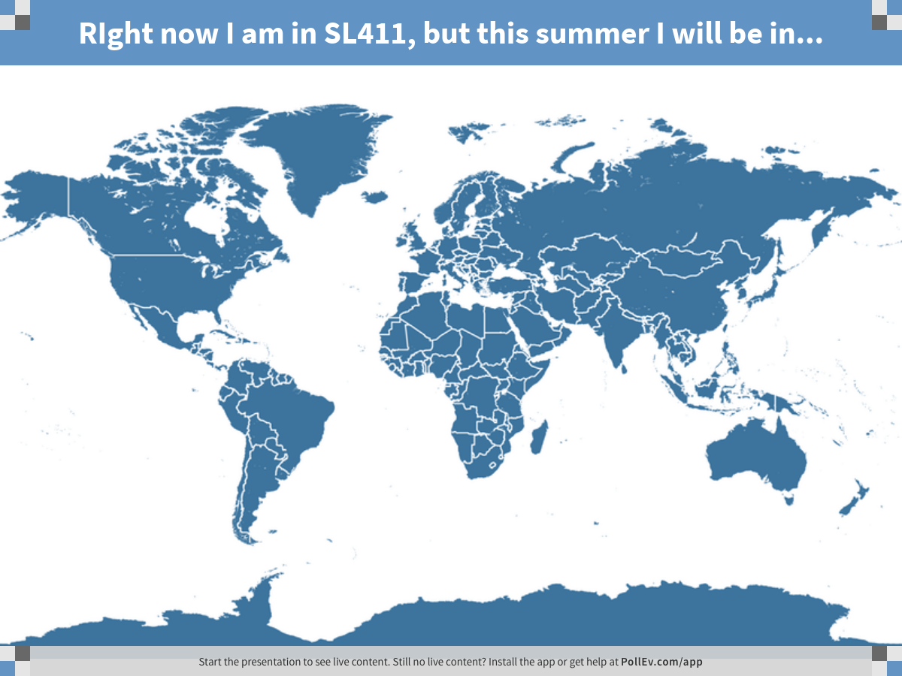
Notes:
RIght now I am in SL411, but this summer I will be in...
https://www.polleverywhere.com/clickable_images/A0LPUGy9nAXYQGz

Slide 3
Chapter 3 Objectives:
Understand how cells use energy: what is the source of this energy, how is it stored, and how is it used
Be able to define free energy and use measures of free energy to determine how a reaction is likely to proceed
Be able to describe and provide examples of several ways in which cells promote unfavorable reactions

Slide 4
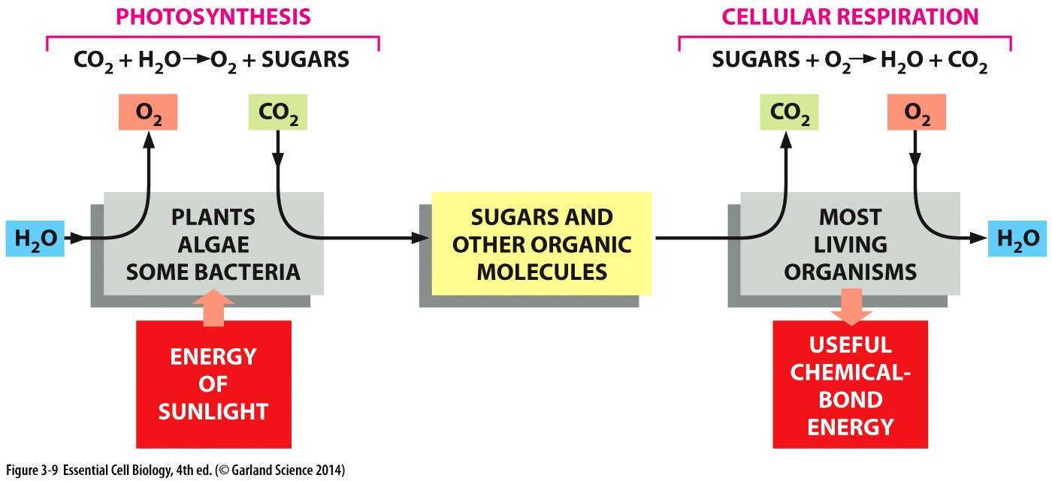

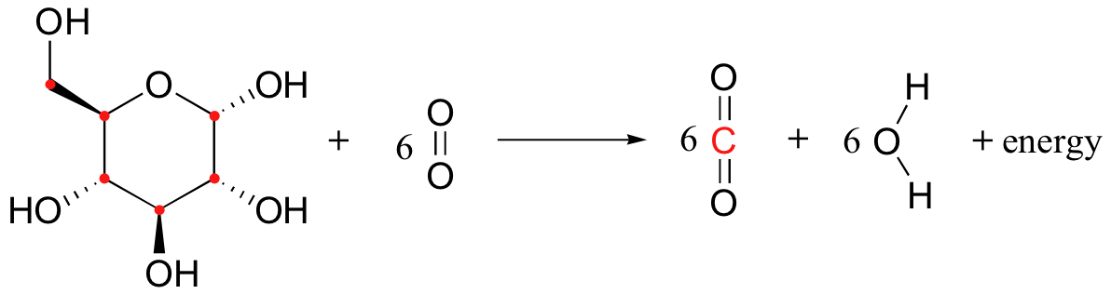
Energy in Chemical Bonds
Chemical energy stored in chemical bonds of organic matter
sugars and other molecules → extract it!
Oxidation reaction (controlled burning)
Break covalent bonds
Consumes molecular oxygen
Produce CO2 and H2O
Oxidation = electrons (H atoms) removed
Reduction= electrons added
Happen simultaneously because electron # is conserved
Energetically stable = favorable
Where do these come from?

Slide 5
Sources of bonds to break?
In plants, energy from the sun is harnessed to make sugars
In animal cells, small and large molecules that are eaten will be used

Slide 6
Convert energy to create order

Slide 7
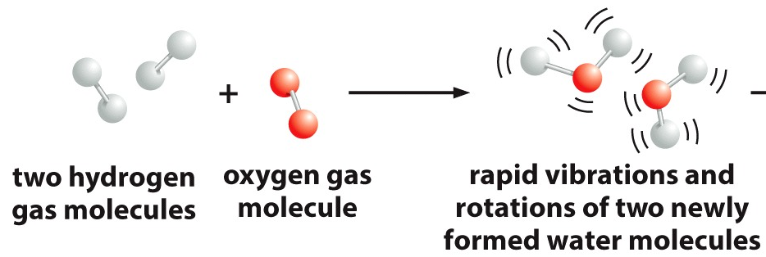
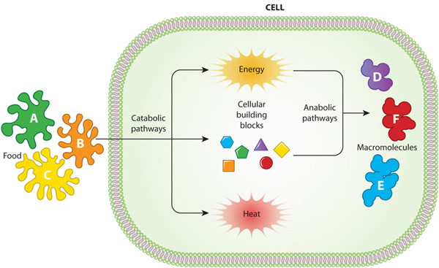
Putting bond energy to work
Break down (catabolize) food to convert energy of chemical bonds to heat
Release heat
+ harness energy
Activated carriers capture and store energy that is released through catabolic pathways

Slide 8
Cells CONVERT energy to CREATE order
Break down (catabolize) food to convert energy of chemical bonds to heat
Release heat
+ harness energy
Activated carriers capture and store energy that is released through catabolic pathways ATP, GTP, NADP
Stored energy used to form new chemical bonds & promote order
Achieve balance: heat released must increase external disorder as much or more than the amount of order achieved inside

Slide 9
favorable chemical reactions

Slide 10
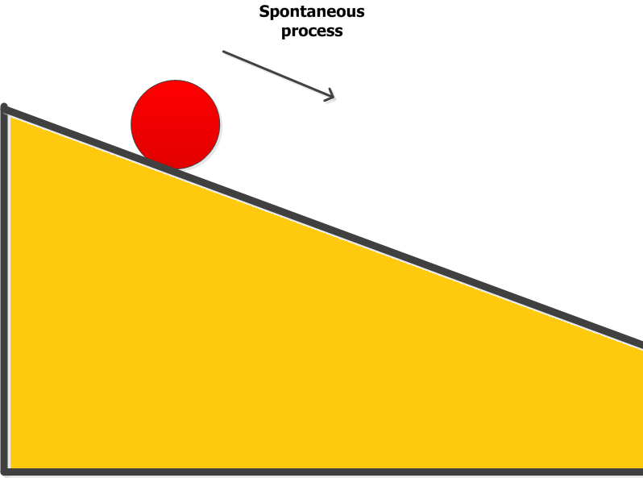
Free Energy
Chemical reactions proceed in the direction that leads to a loss of free energy (energy to do work: c-b= ΔG)
Measure in kJ/mol
More disorder = less free energy (negative ΔG)
energy is needed to create order (positive ΔG)
b
c

Slide 11
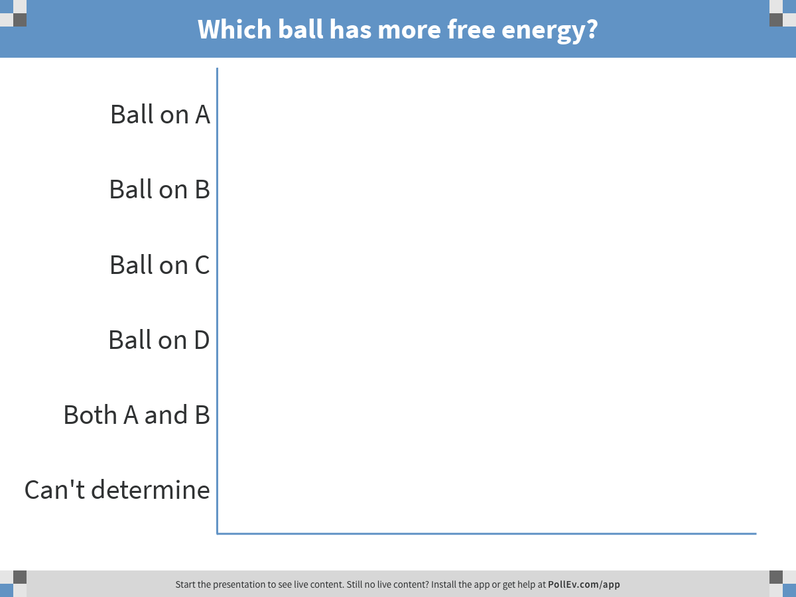
A
B
C
D
Notes:
Which ball has more free energy?
https://www.polleverywhere.com/multiple_choice_polls/f5wgffjv0kkAaKF

Slide 12
Which ball has more free energy?
b
A
B
b
C
D
c
c
Free energy= difference between point c and b
What limits the release of free energy from the ball on box A?

Slide 13
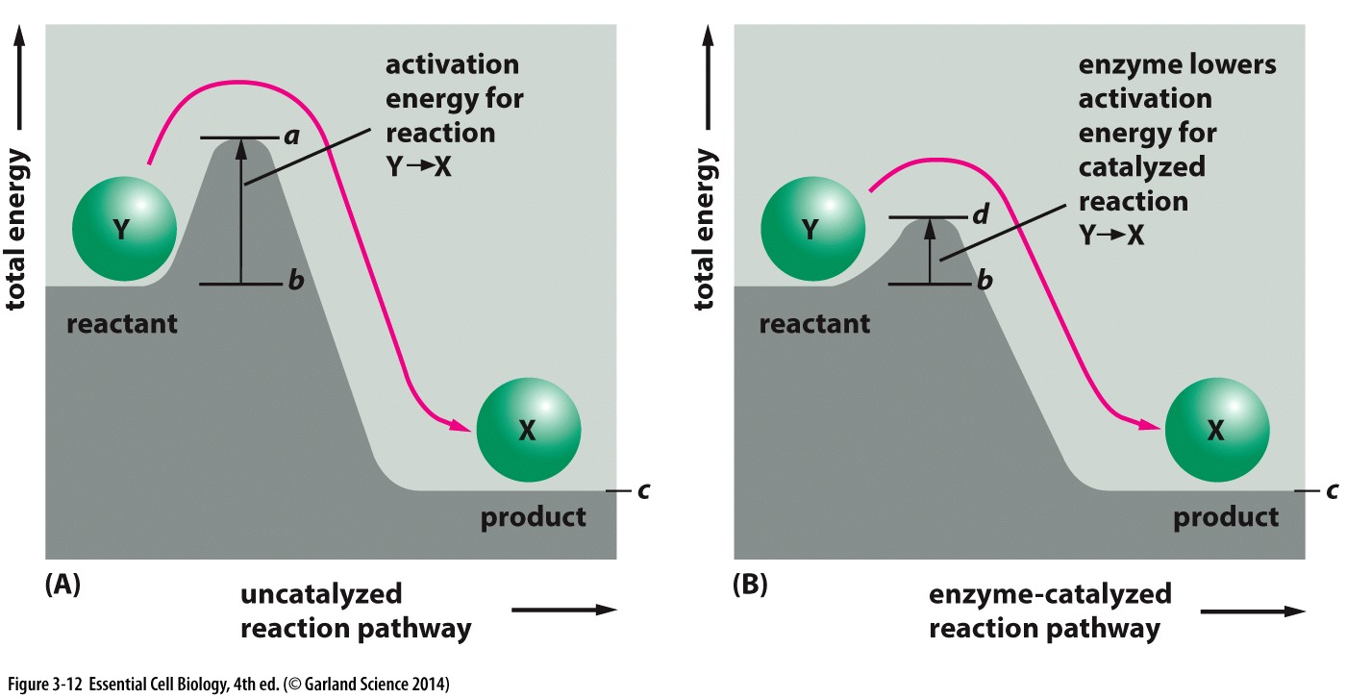
Free Energy
Chemical reactions proceed only in the direction that leads to a loss of free energy (energy to do work: c-b = ΔG)
More disorder = less free energy (negative ΔG)
energy is needed to create order (positive ΔG)
BUT even energetically favorable reactions can’t always proceed at cellular condition
Cellular compounds in a stable state require activation energy to change to a lower energy state

Slide 14
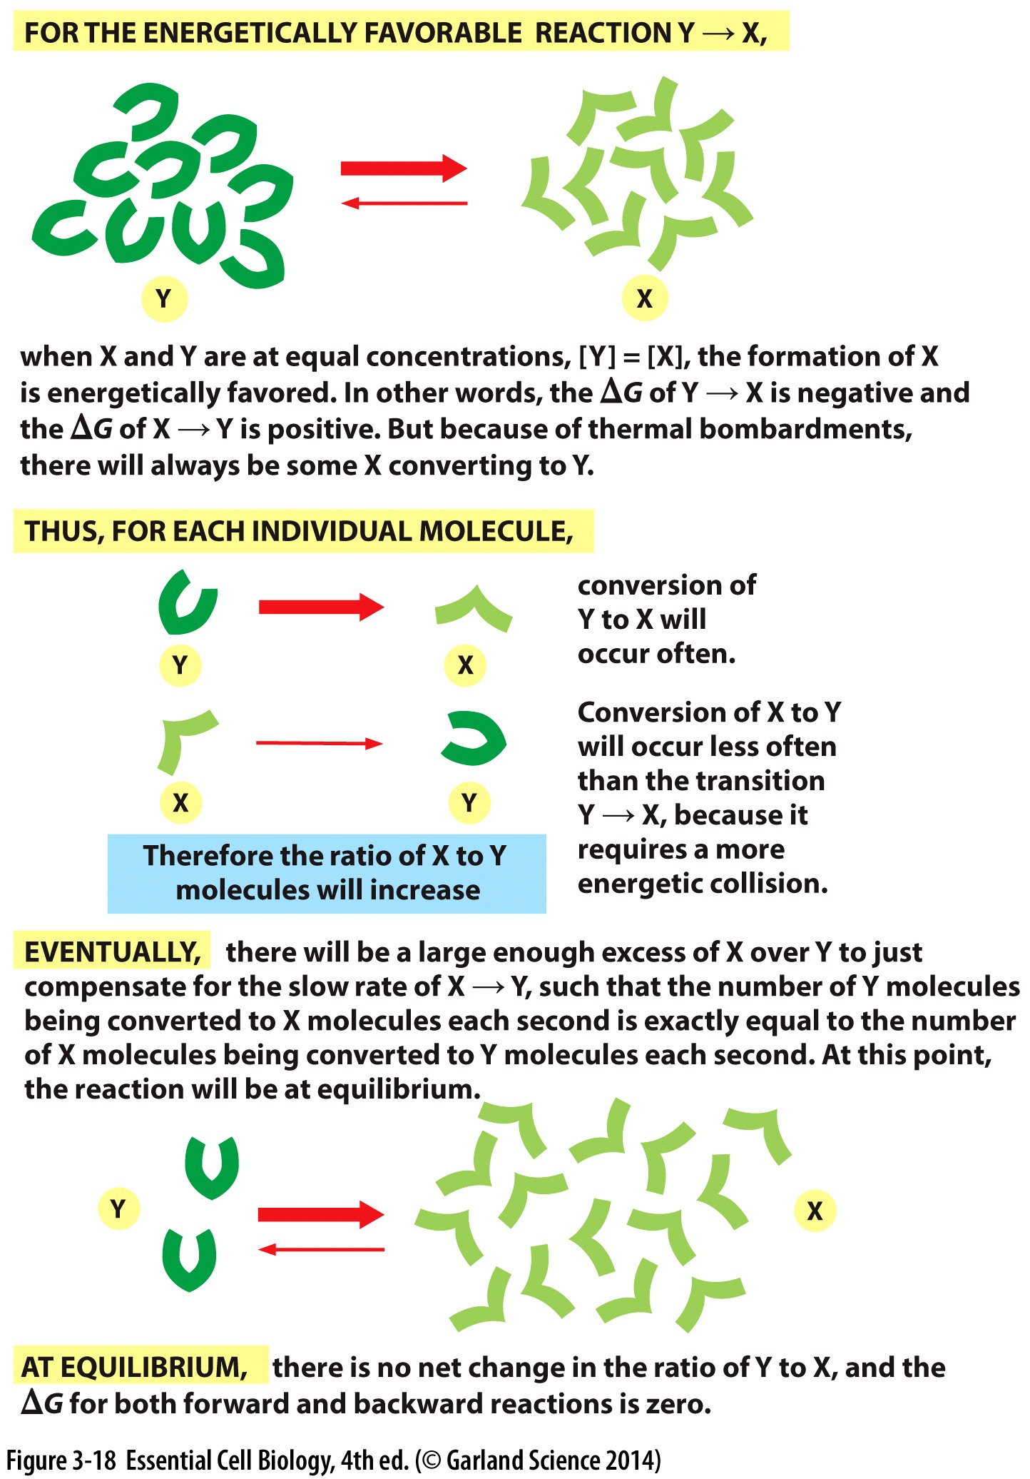
Reactions proceed to equilibrium
Y→X is faster than X→Y
BUT:
more Y→X reaction= > X
more likely X→Y
ΔG depends on the concentrations
Equilibrium is reached when concentrations of X and Y are stable
eventually

Slide 15
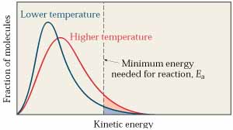
Activation energy limits spontaneous reactions
Only a fraction of molecules have enough energy to overcome the activation energy
Favorable reactions can be VERY SLOW…even years to happen
Heat can increase # molecules that have higher kinetic energy
Not easy to manipulate in cells
Notes:
Better option to help these reactions proceed?

Slide 16
Enzymes catalyze reactions
Reduce the energy needs (activation energy) to initiate spontaneous reactions:
Still proceed from less favorable → more favorable
do not change the DIRECTION of a reaction

Slide 17
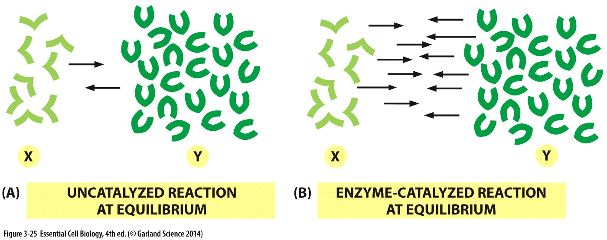
Enzymes and Equilibrium
Enzymes increase reaction rate (both forward and reverse)
Reaction obtains equilibrium faster
BUT equilibrium ratio in NOT altered

Slide 18
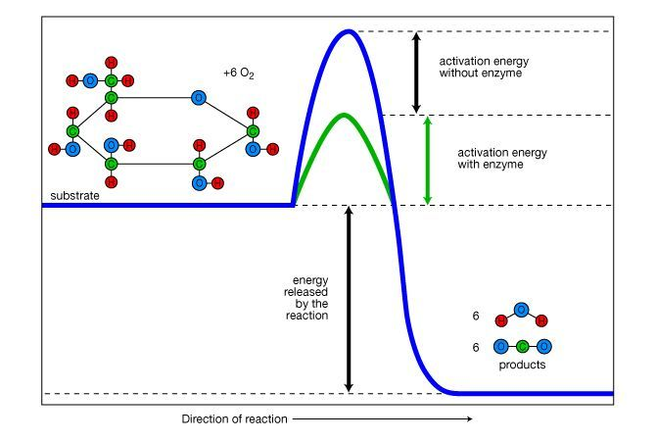
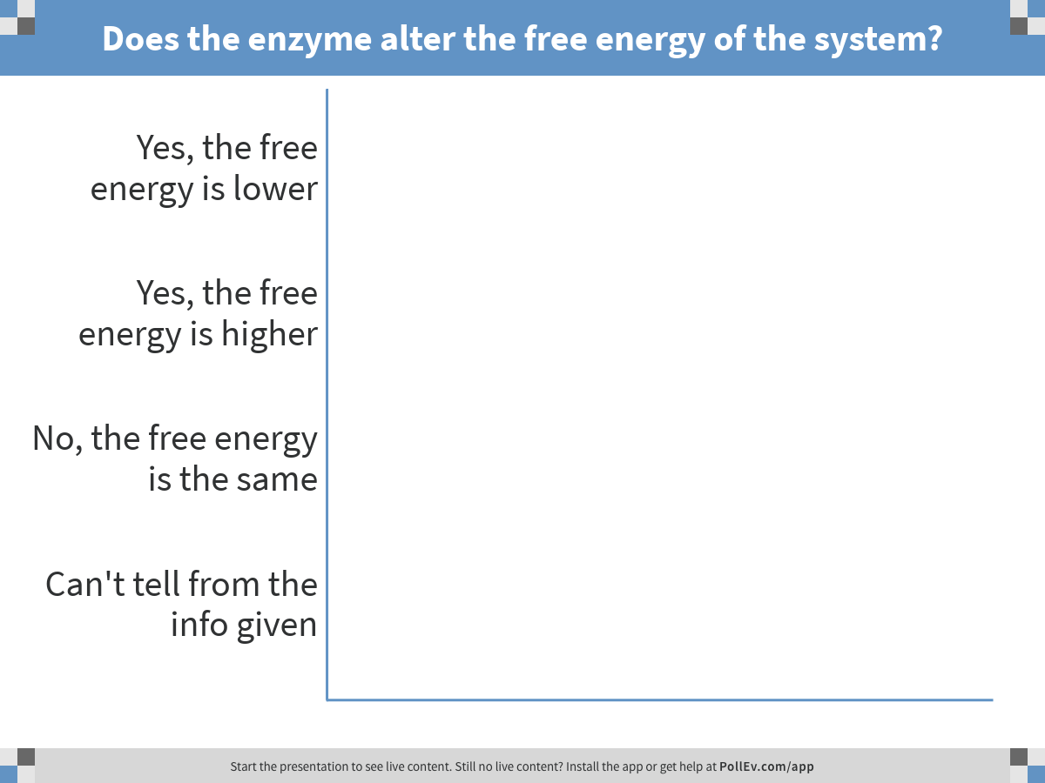
Notes:
Does the enzyme alter the free energy of the system?
https://www.polleverywhere.com/multiple_choice_polls/IU1L05eSCjIbwcT

Slide 19
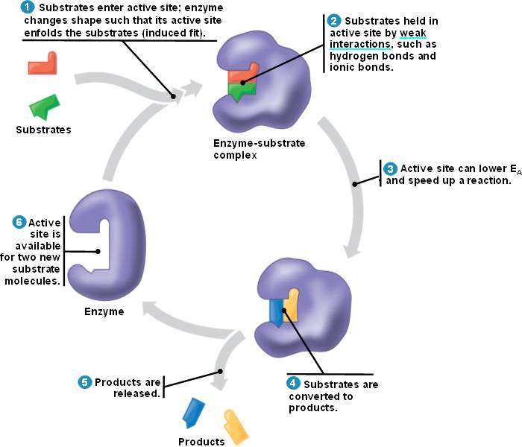
Enzymes catalyze reactions
Reduce the energy needs (activation energy) to initiate spontaneous reactions:
Still proceed from less favorable → more favorable
do not change the DIRECTION of a reaction
Highly selective of their substrates
Use non covalent interactions to hold substrate
Lowers activation energy
Converts substrates to products while enzyme remains UNCHANGED
Releases product(s)
Reaction can be repeated/enzyme reused

Slide 20
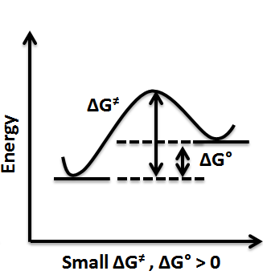
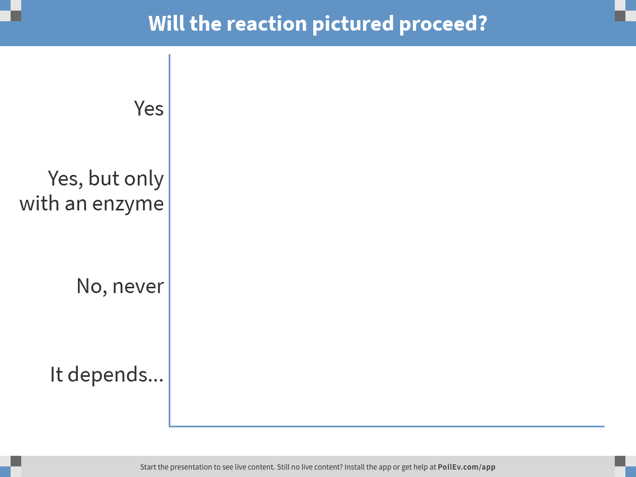
Notes:
Will the reaction pictured proceed?
https://www.polleverywhere.com/multiple_choice_polls/cH1IR0C7N7DD5Rf

Slide 21
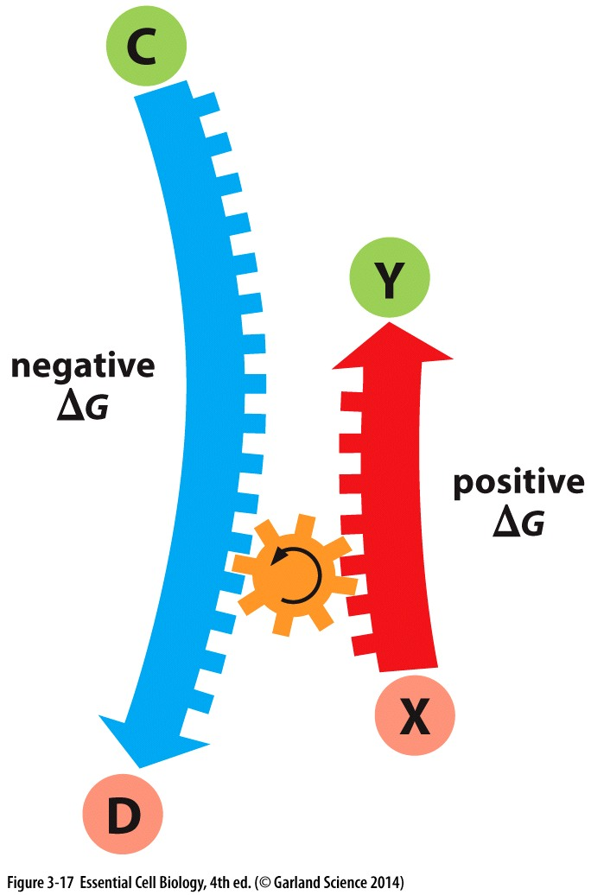
Favorable reactions
Unfavorable reactions
Occur when ΔG is negative:
Free energy released by the reaction (product-substrate)
Favorable concentration
Enzymes promote spontaneous reactions by:
reducing activation energy
Occur when:
Concentration of the product is high enough
Coupled to an
energetically
favorable reaction

Slide 22
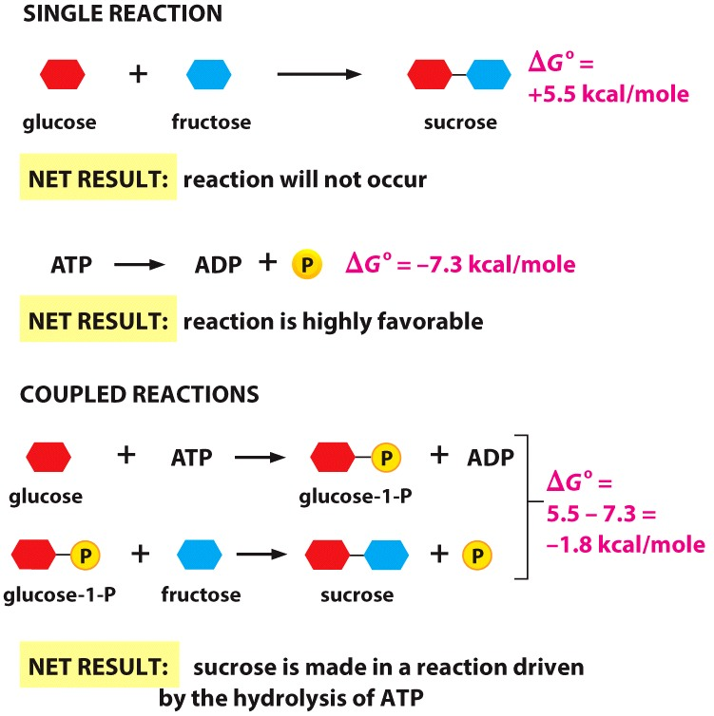
Coupled reactions
Reaction will proceed if overall free energy change (ΔG°) of coupled reactions is negative
Energy is lost as heat during this transfer so:
ΔG of C→D
must be >
ΔG of Y→X
Notes:
2 sugars joined by a condensation reaction that creates a glycosidic bond
In contrast, the phosophoanhydride in ATP is a high energy bond. The terminal phosphate is readilt transferred to other molecules as aless energy rich bond and so ha s alarge neg G

Slide 23
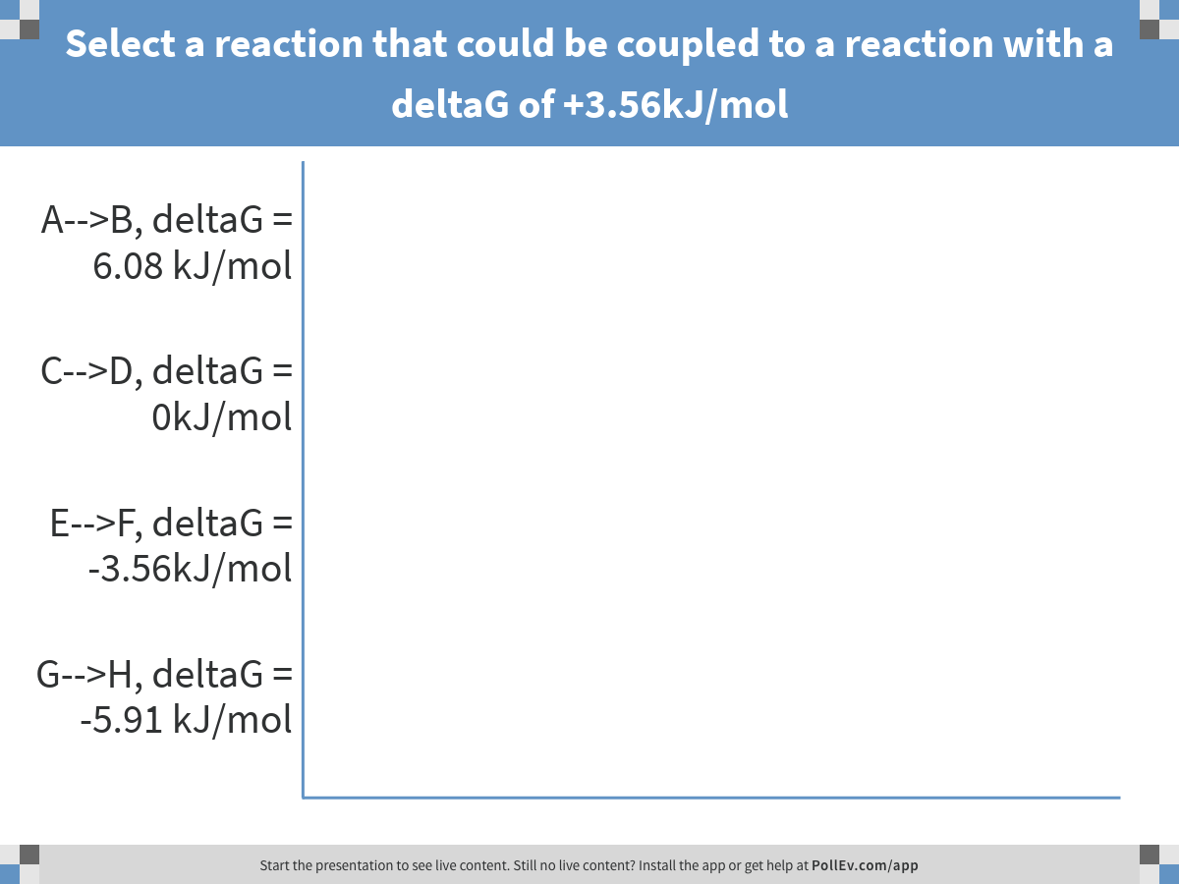
Notes:
Select a reaction that could be coupled to a reaction with a deltaG of +3.56kJ/mol
https://www.polleverywhere.com/multiple_choice_polls/Hdswc1HHU8SLWjY

Slide 24
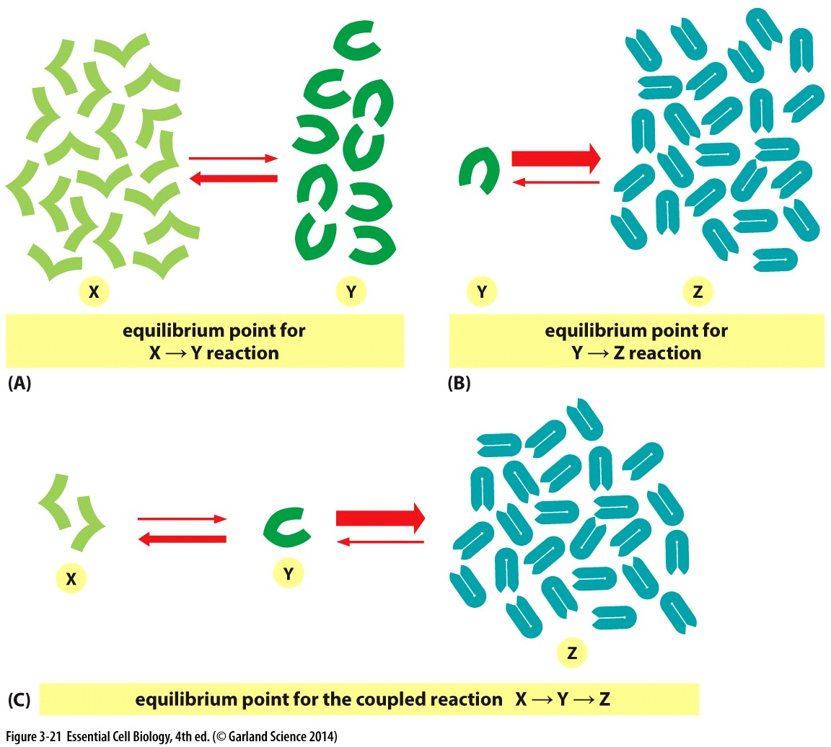
Sequential reactions
Can drive unfavorable reactions by keeping product concentration low

Slide 25
Moving things along…
A reaction needs
Here comes help..

Slide 26
Moving things along…
A reaction needs
Here comes help..
Sufficient substrate conc
Multiple substrates to me appropriate contact
Overall free energy of the reaction (favorable
Low activation energy or high kinetic energy
Enzymes provide:
Increased local concentration
Promote appropriate contacts
→→decreased activation energy
Coupled reactions provide
Free energy from favorable reactions
Decreased product concentrations

Slide 27
Unfavorable reaction?
Favorable reaction?
With enzyme?
With coupled reaction?
Free energy
Reaction coordinate

Slide 28
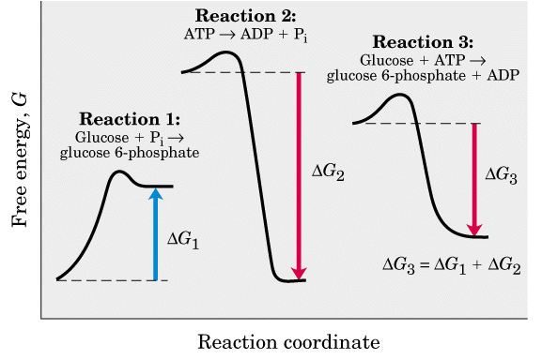
Unfavorable reaction?
Favorable reaction?
With enzyme?
With coupled reaction?

Slide 29
Chapter 4 Objectives
Understand how the shape of proteins is defined by their linear sequence
Be able to describe common folding patterns and where they might be found in a protein
Be able to describe primary, secondary, tertiary and quaternary structure of a protein
Be able to describe, with examples, how a protein’s three dimensional shape may indicate it’s function

Slide 30
Shape and Structure of Proteins

Slide 31
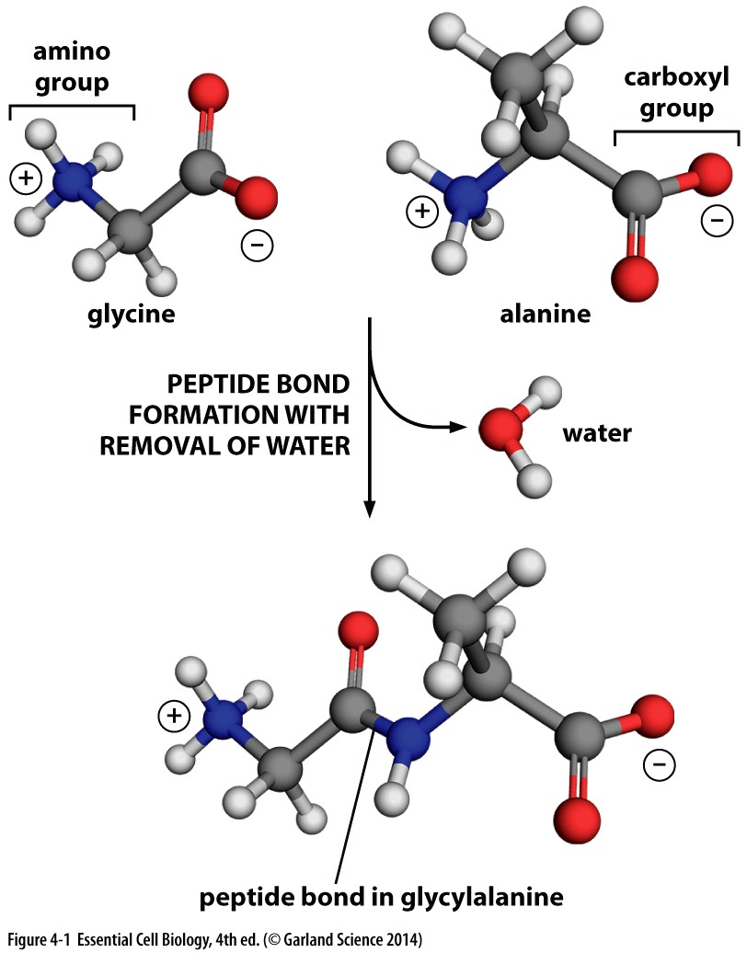
Shape of a protein
Shape is specified by amino acid sequence (Chapt 2)
Chains of amino acids joined by peptide bonds= polypeptide chains
condensation
Reaction →

Slide 32
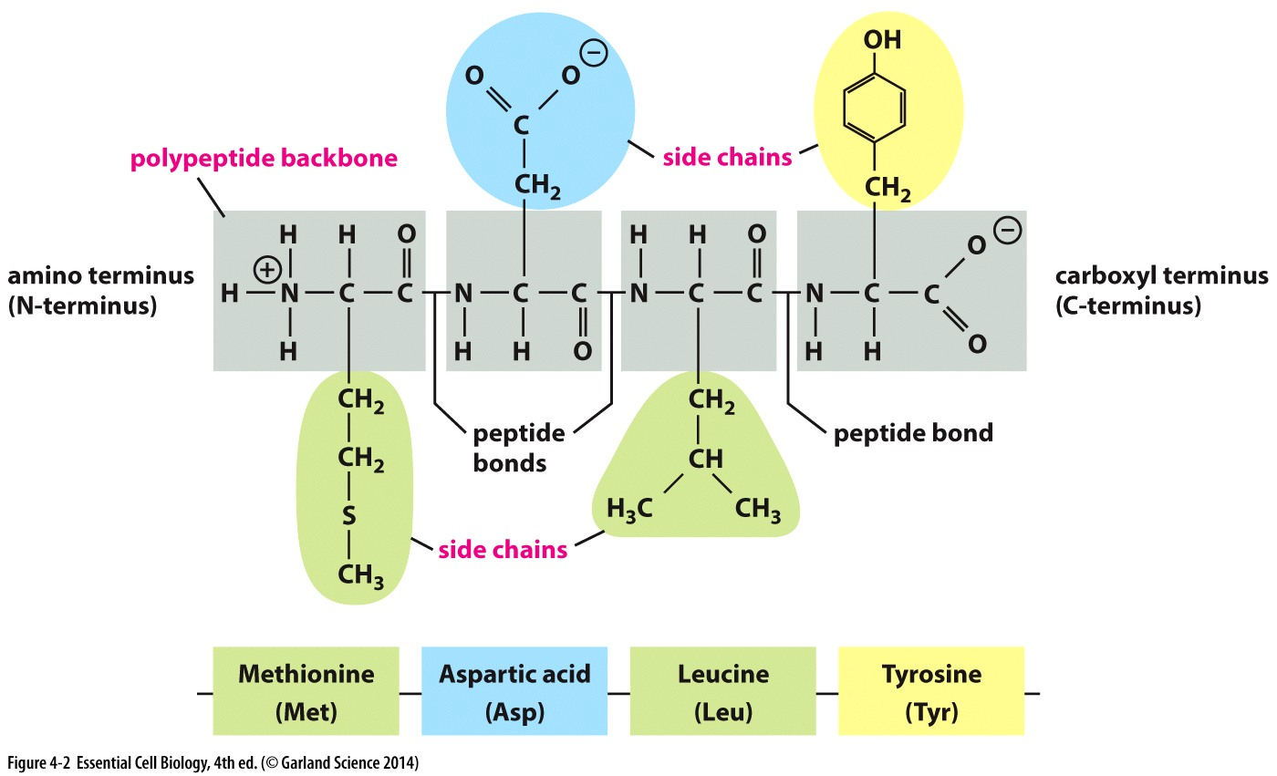
Primary Structure
20 amino acids common in all living organisms
Each molecule of a protein has an identical amino acid sequence
Each protein has distinct amino acid sequence
This linear sequence defines a protein’s primary (1°) structure

Slide 33
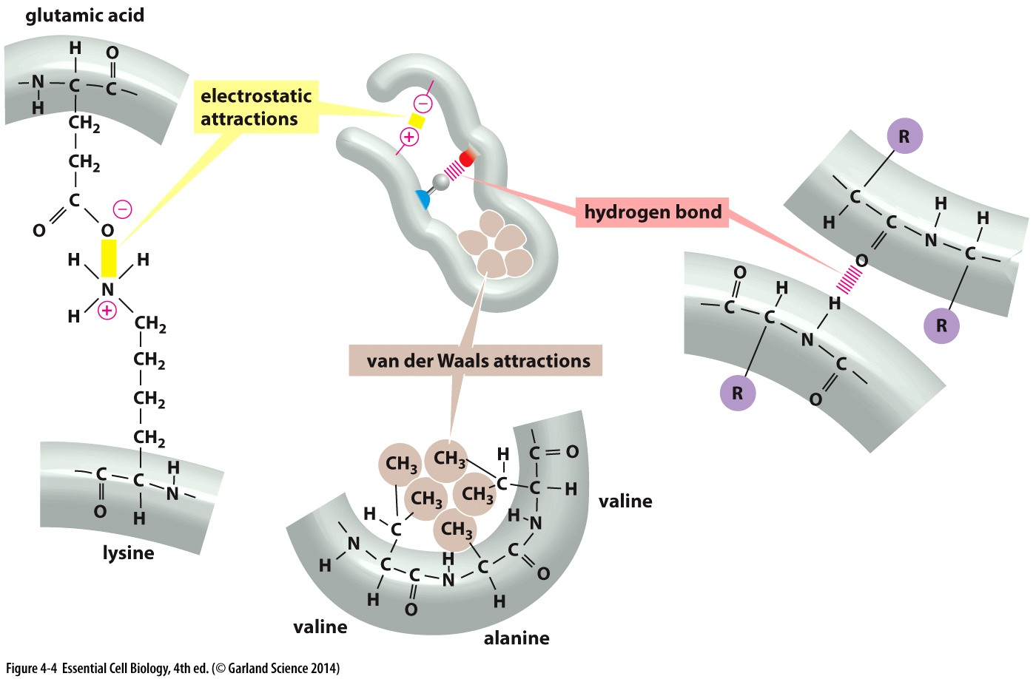
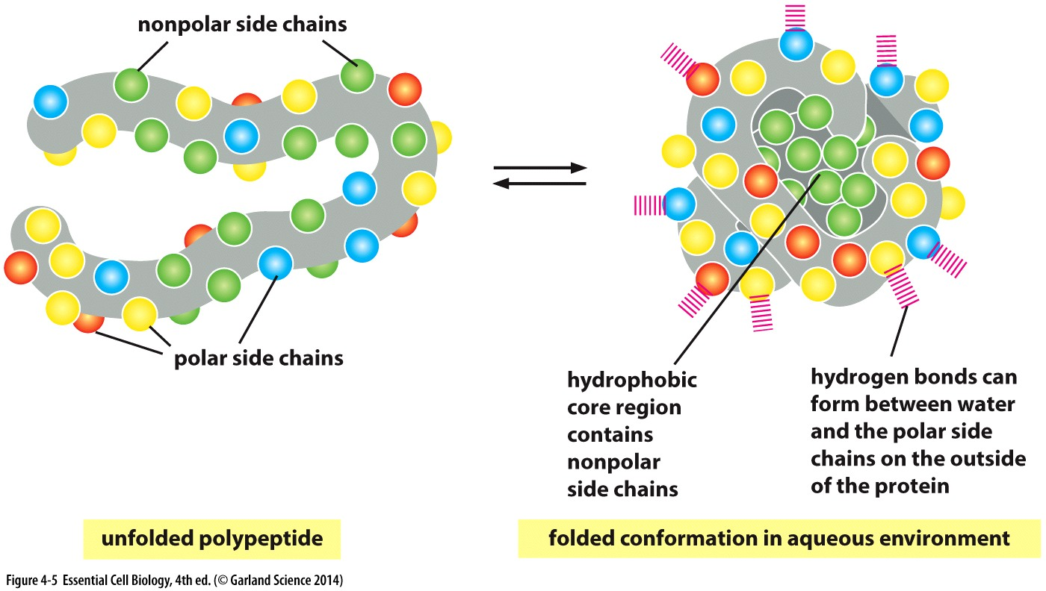
How do proteins fold?
Polypeptide chains are flexible
Properties of amino acid side chains influence how sections of a protein fold
A protein’s final conformation is where it’s free energy is minimized = lowest energy
If unfolded, can re-achieve the same folded conformation

